Slide 1
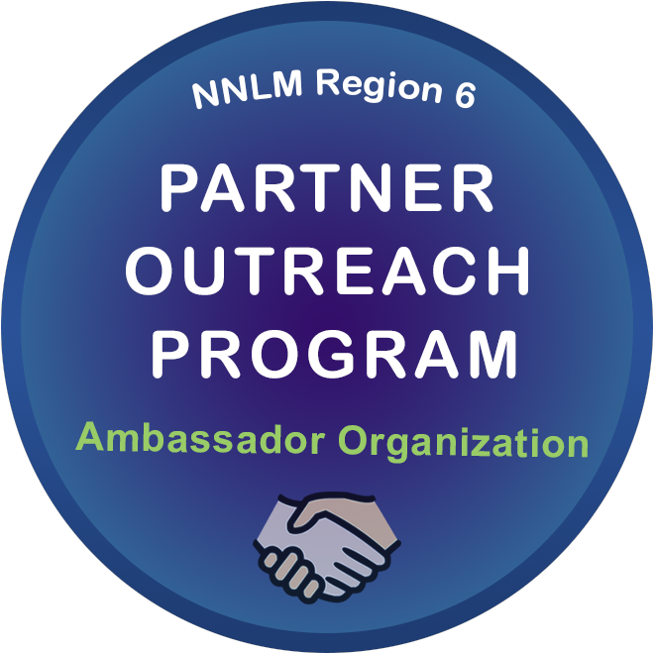
We are a proud Partner Outreach Program Ambassador Organization
Notes:
The purpose of the NNLM Region 6 Partner Outreach Program 2021-2026 is to support health equity by providing health information access throughout Region 6 by the formation and practice of the Partner Outreach Program (POP). NEOBHC is one of 15 POP Ambassador Organization.

Slide 2
NIH Acknowledgement
Developed resources reported in this presentation are supported by the National Library of Medicine (NLM), National Institutes of Health (NIH) under cooperative agreement number UG4LM013729. The content is solely the responsibility of the authors and does not necessarily represent the official views of the National Institutes of Health.

Slide 3
MedlinePlus.gov Trusted Health Information for You
High quality health information
No advertisements
Purely educational
From the National Library of Medicine
Notes:
MedlinePlus is a service of the National Library of Medicine (NLM), the world's largest medical library, which is part of the National Institutes of Health (NIH).
The mission of MedlinePlus is to present high-quality, relevant health and wellness information that is trusted, easy to understand, and free of advertising, in both English and Spanish. Anywhere, anytime, on any device—for free.
The simplest way to search is to enter your search in the “Search MedlinePlus” box and select “Go”!

Slide 4
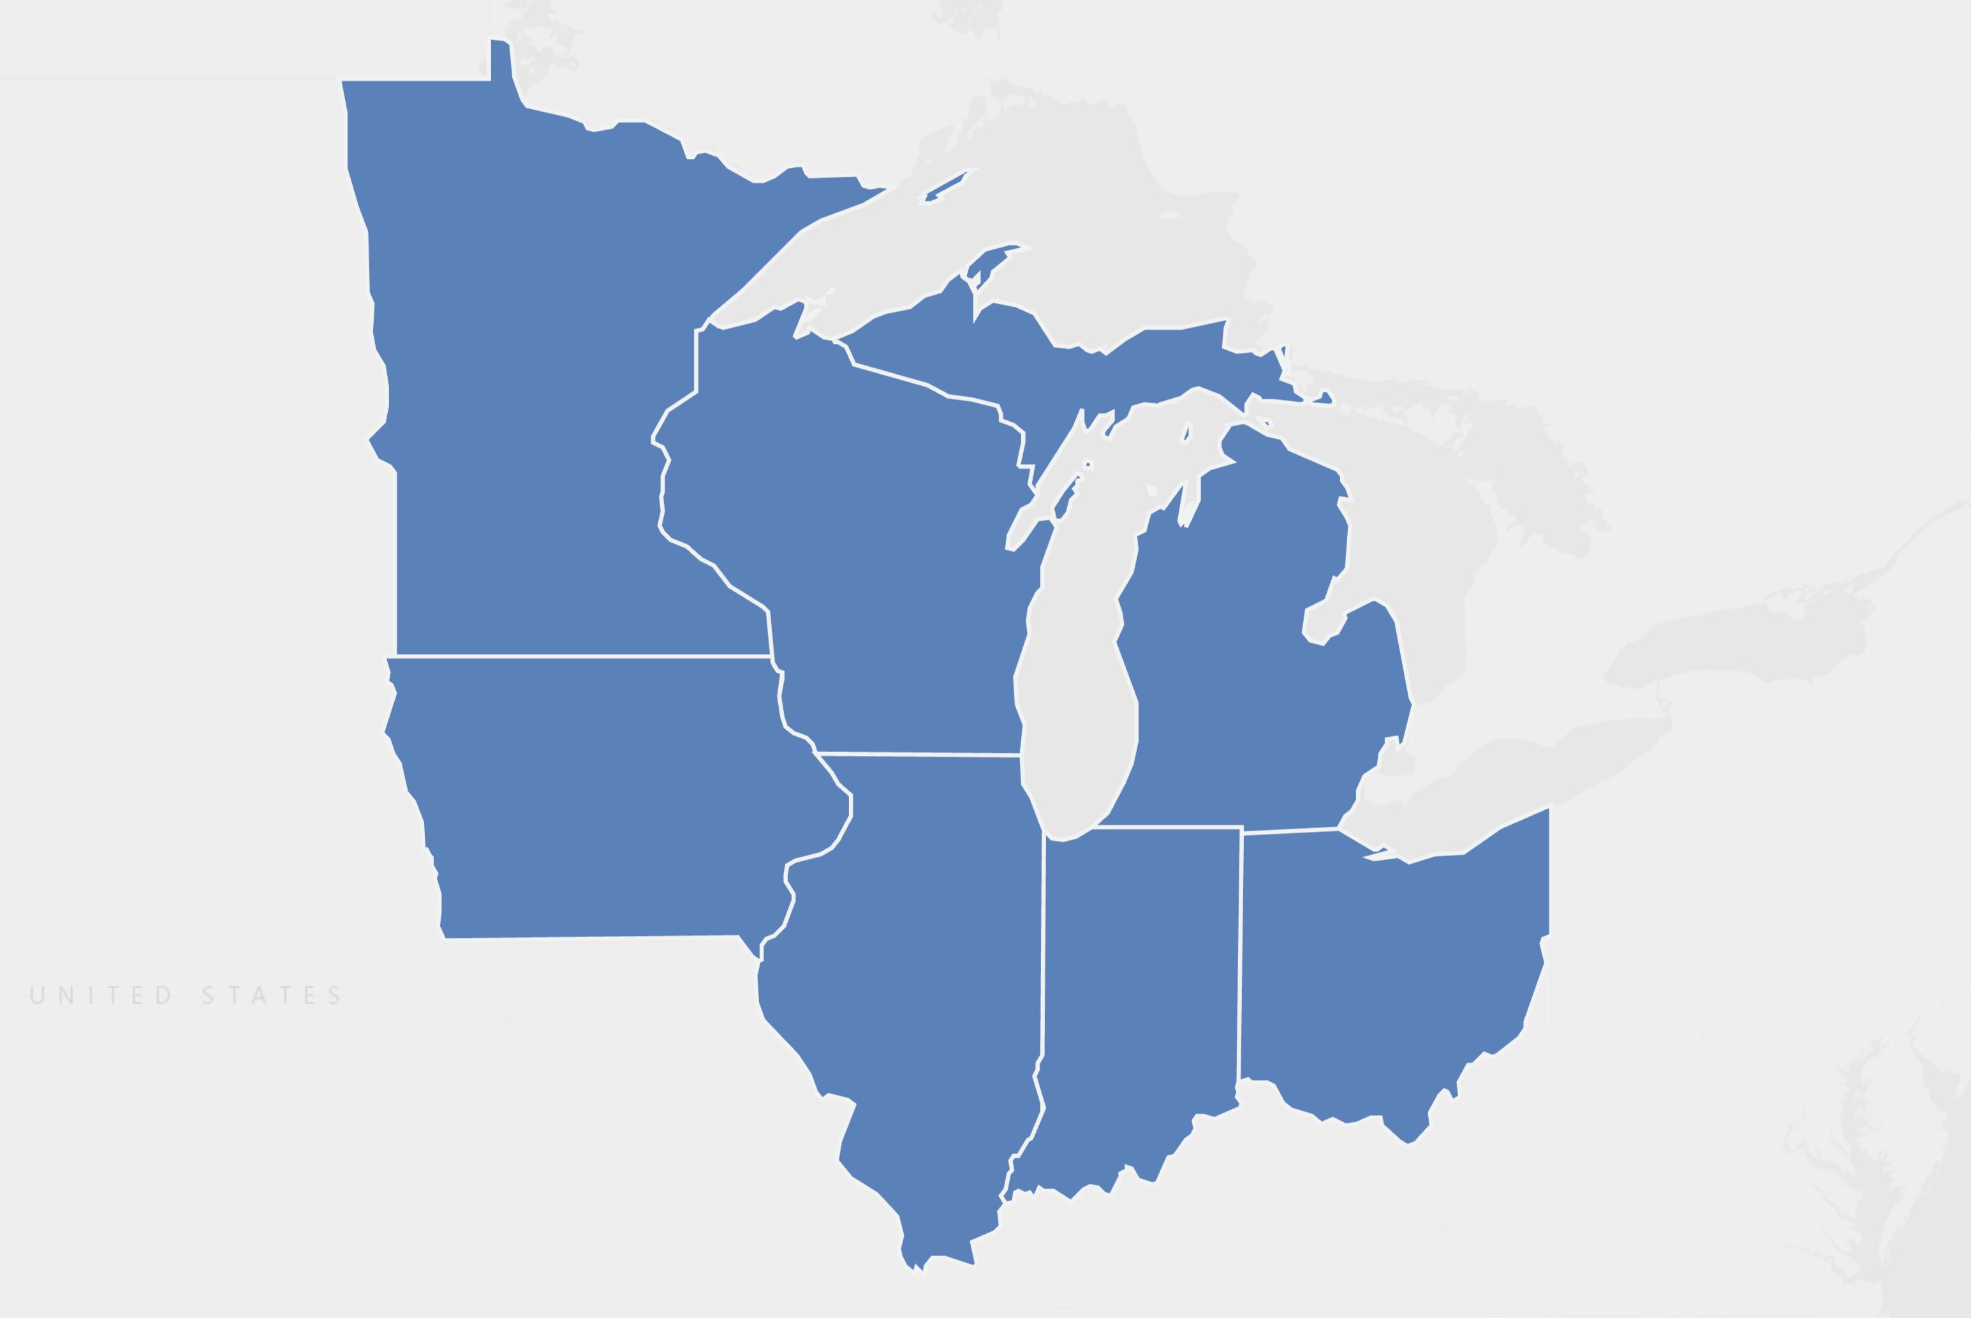
The mission of the NNLM is to provide U.S. researchers, health professionals, public health workforce, educators, and the public with equal access to biomedical and health information resources and data.
Region6-RML@uiowa.edu
nnlm.gov
This project has been funded in whole or in part with Federal funds from the Department of Health and Human Services, National Institutes of Health, National Library of Medicine, under Grant Number UG4 LM013729 with the University of Iowa.
Notes:
The NNLM consists of 7 regional medical libraries and thousands of member organizations located throughout the US. The mission of the NNLM is to provide U.S. researchers, health professionals, public health workforce, educators, and the public with equal access to biomedical and health information resources and data. The RMLs carry out regional and national programs in support of the mission. This includes training, funding, and engagement opportunities for member libraries and other organizations to carry out regional and national programs. Regionally, RMLs assess and interpret the needs of current and potential audiences to expand the reach and impact of the National Library of Medicine (NLM). As a group, the RMLs ensure continuity for essential programs of the NNLM, and cooperatively design, implement, and evaluate innovative approaches to serving the biomedical and health information needs of researchers, health professionals, public health workforce, educators, and the public in communities across the U.S., including persons who experience health disparities and populations underrepresented in biomedical research.

