Slide 1
REMOVE THIS SLIDE BEFORE PRESENTING!
This slide deck is intended to introduce and demo the basics of MedlinePlus to new users.
It takes around 30-45 minutes to present.
The content is pulled from the on-demand MedlinePlus Tutorial for Librarians and Health Educations
Please feel free to edit, abridge, expand, re-use, and/or re-distribute this presentation however you like.
We encourage you to replace the included examples with searches more relevant to your specific audience.
Notes:
[These slides were created by the Office of Engagement and Training (OET) at the U.S. National Library of Medicine, based on the on-demand MedlinePlus Tutorial for Librarians and Health Educations.
We encourage you to copy and adapt these slides to your outreach and training needs and style appropriate to your audience. These slides are free of copyright restriction, but we appreciate attribution to the U.S. National Library of Medicine.
These slides were created at in mid August 2023. Please keep your materials up to date by testing all examples and assertions using MedlinePlus (https://medlineplus.gov/).
If you have questions or comments about these slides, please write to NLMTrainers@nih.gov.]

Slide 2
Introduction to MedlinePlus

Slide 3
Learning Objectives
Explain why MedlinePlus is an authoritative source of health information for consumers;
Identify website features;
Find information on specific health topics and tools;
Find information on specific drugs, herbs and supplements,
Find information on genetics, and medical tests

Slide 4
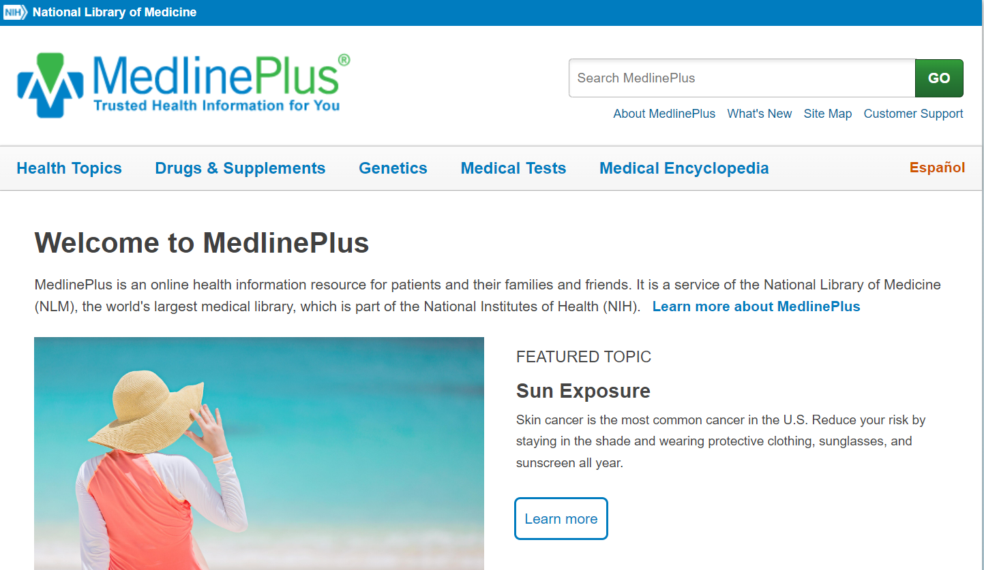
Background Information
Notes:
Consumers struggle to determine if the health information they find online is reliable. They can also be overwhelmed by the amount of information available. Recent studies have shown that cancer patients often struggle with which sources to trust. In addition, patients with rare diseases who seek out new research about their disease are unsure of how to incorporate what they find into their everyday lives.
MedlinePlus is designed to meet these needs. MedlinePlus is the National Institutes of Health's website for patients and the public.
Produced by the National Library of Medicine, it offers trusted and current health information about diseases, conditions, and wellness issues in both Spanish and English.
MedlinePlus is available anytime, anywhere, for free. Its content is developed to incorporate best practices for web accessibility and is compatible with assistive technology like screen readers. MedlinePlus explains complex medical conditions using everyday language.
Consumers can access MedlinePlus for brief or in-depth explanations of a health topic, and health care providers can confidently refer their patients to it.
Consumers commonly use the Internet to answer questions about specific health problems, drugs or supplements, parts of the body, and diagnostic procedures. The MedlinePlus website is designed for consumers to easily search or browse in these areas.
There are three main sections on the site: Health Topics, Drugs & Supplements, and Medical Tests. The site also includes a section on Genetics and the Medical Encyclopedia. You can also use the search box at any time to search the entire website.
Within each of these collections, you can search or browse for topics. Topic pages follow a standardized template with clear structure and navigation so users can quickly get to the information they need.

Slide 5
Sources
National Library of Medicine (NLM)
National Institutes of Health (NIH)
Centers for Disease Control and Prevention (CDC)
Food and Drug Administration (FDA)
NIH Office of Dietary Supplements
Notes:
Currently, MedlinePlus is sourced from more than 1,600 selected organizations and provides 18,000 links to authoritative health information in Spanish and 40,000 links to information in English.
MedlinePlus links to information produced by the National Library of Medicine (NLM), the National Institutes of Health (NIH) and other trusted health-related organizations within the U.S. Federal Government, such as:
Centers for Disease Control and Prevention (CDC); the
Food and Drug Administration (FDA); and the
NIH Office of Dietary Supplements
Links to other websites, particularly ones with unique information or special features, are included if they meet specific Quality Guidelines. See this link to learn more about MedlinePlus Sources and the selection process
https://medlineplus.gov/about/general/reviewandupdate/

Slide 6
MedlinePlus Quality Guidelines
The quality, authority and accuracy of the health content.
The primary purpose of the resource is educational and not to sell a product or service, with most content being available at no charge.
The resource is reliable and regularly maintained.
Notes:
There are three major guidelines for selecting resources to include in MedlinePlus:
The quality, authority and accuracy of the health content; The primary purpose of the resource is educational and not to sell a product or service, with content being available at no charge; and the resource is reliable and regularly maintained.
Link to MedlinePlus Quality Guidelines:
https://medlineplus.gov/about/using/criteria/

Slide 7
Health Topics
MedlinePlus began in 1998 with 22 health topics.
Currently, there are more than 1,000 health topics in Spanish and English.
MedlinePlus health topics are regularly reviewed, and links are updated daily
Notes:
MedlinePlus began in 1998 with 22 health topics as a means of providing the public with accurate health information from trusted sources. Currently, there are more than 1,000 health topics in Spanish and English. MedlinePlus health topics are regularly reviewed, and links are updated daily. You can find health topics either by searching or browsing alphabetically.
We will provide an overview of the Health Topics section and you will practice finding health topics in MedlinePlus.

Slide 8
Search Health Topics
Notes:
Let’s practice how to do a search for a Health Topic. Look for the search box near the top of the MedlinePlus website. You can use the search box to search all of MedlinePlus.
Enter the term “covid-19” in the search box and then click “Search”

Slide 9
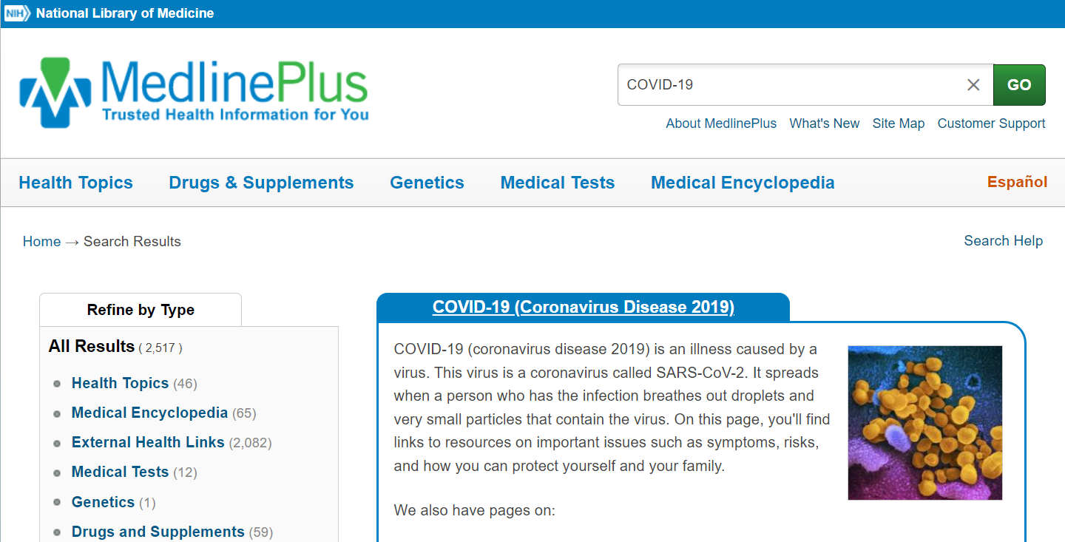
Filtering
Notes:
You can filter your results to better identify what you are looking for.
In the “Refine by Type” box, you can filter your results to Health Topics, among other options. This will limit your results to only predetermined MedlinePlus health topics.
Click on “Health Topics” under the “Refine by Type” box.

Slide 10
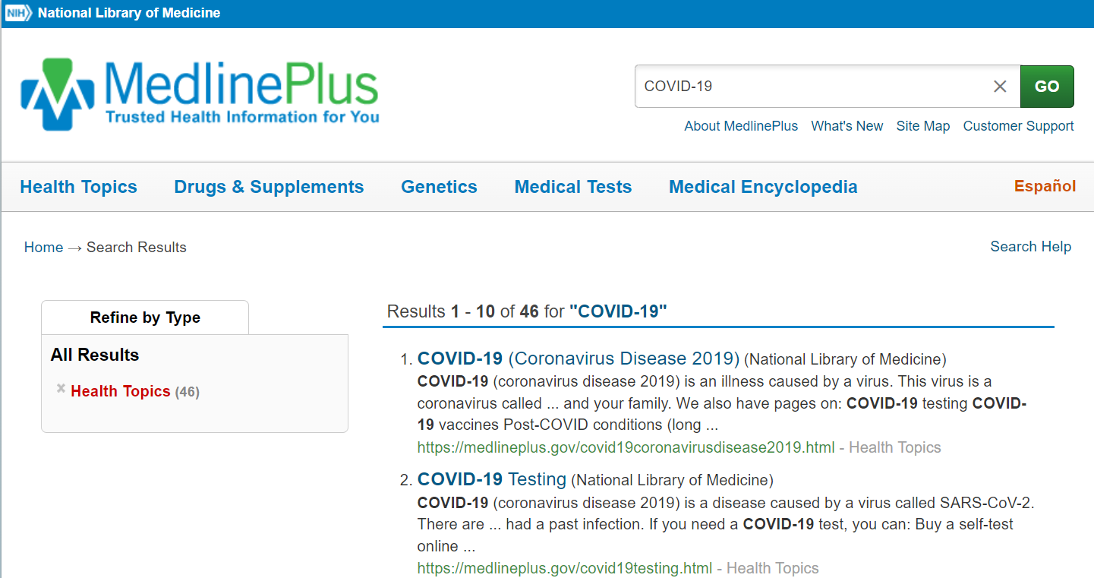
COVID-19 Search Results
Notes:
The number of search results has reduced to feature only health topics. Let’s click on one of the search results to view that health topic.
Click on “COVID-19 Testing”

Slide 11
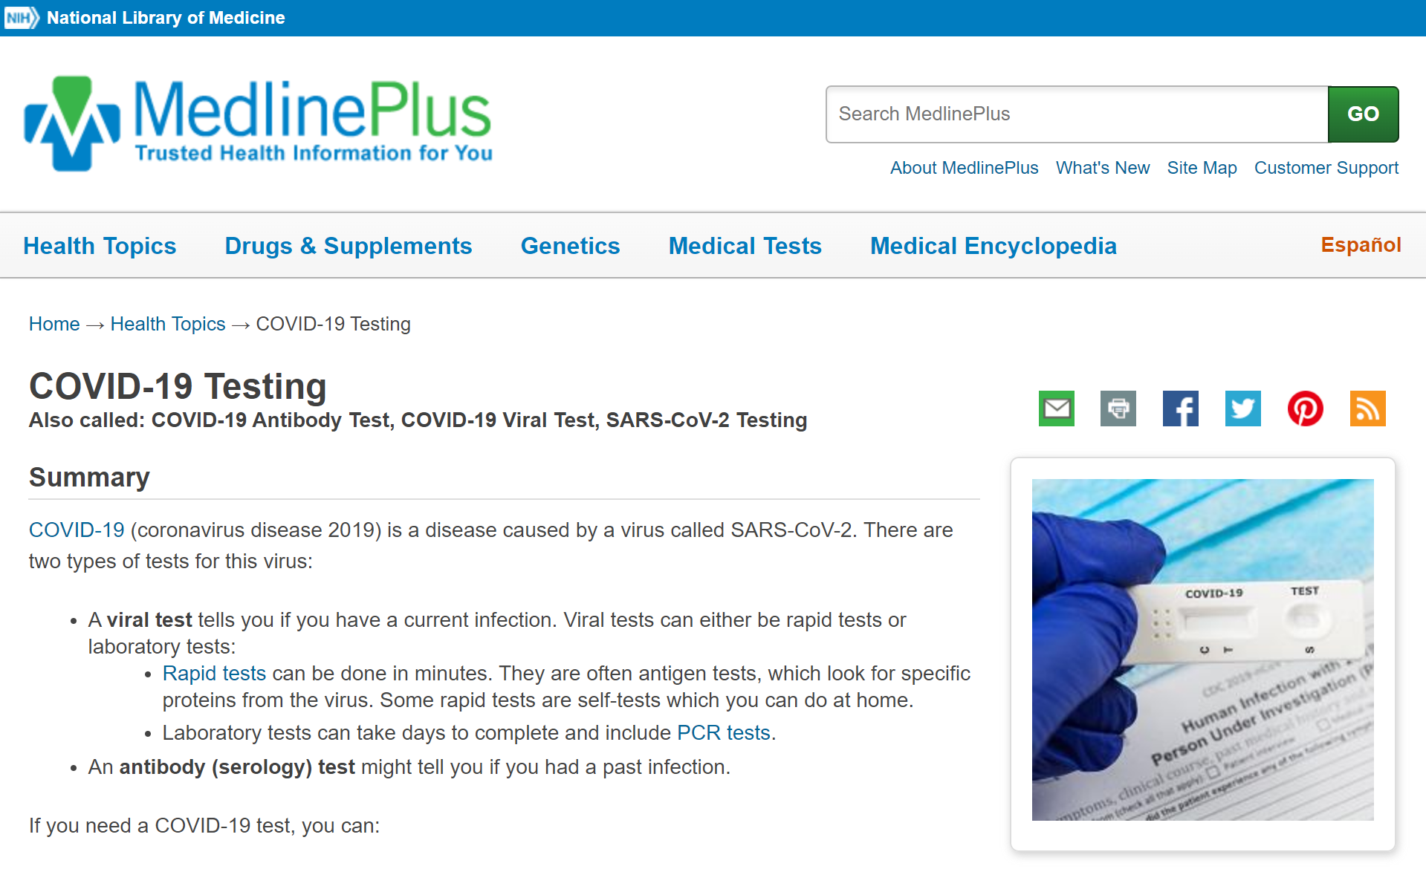
Health Topic Page for COVID-19
Notes:
This is the health topic page for COVID-19 Testing. Later, we will explore a health topic page in more detail.
Searching is one way to find a health topic page. Let’s try another way to find health topics through browsing.
Click the MedlinePlus logo to return to the MedlinePlus homepage.

Slide 12
Browsing Health Topics
Notes:
Browsing involves going to the Health Topics section of the website.
Click on Health Topics in the navigation menu.

Slide 13
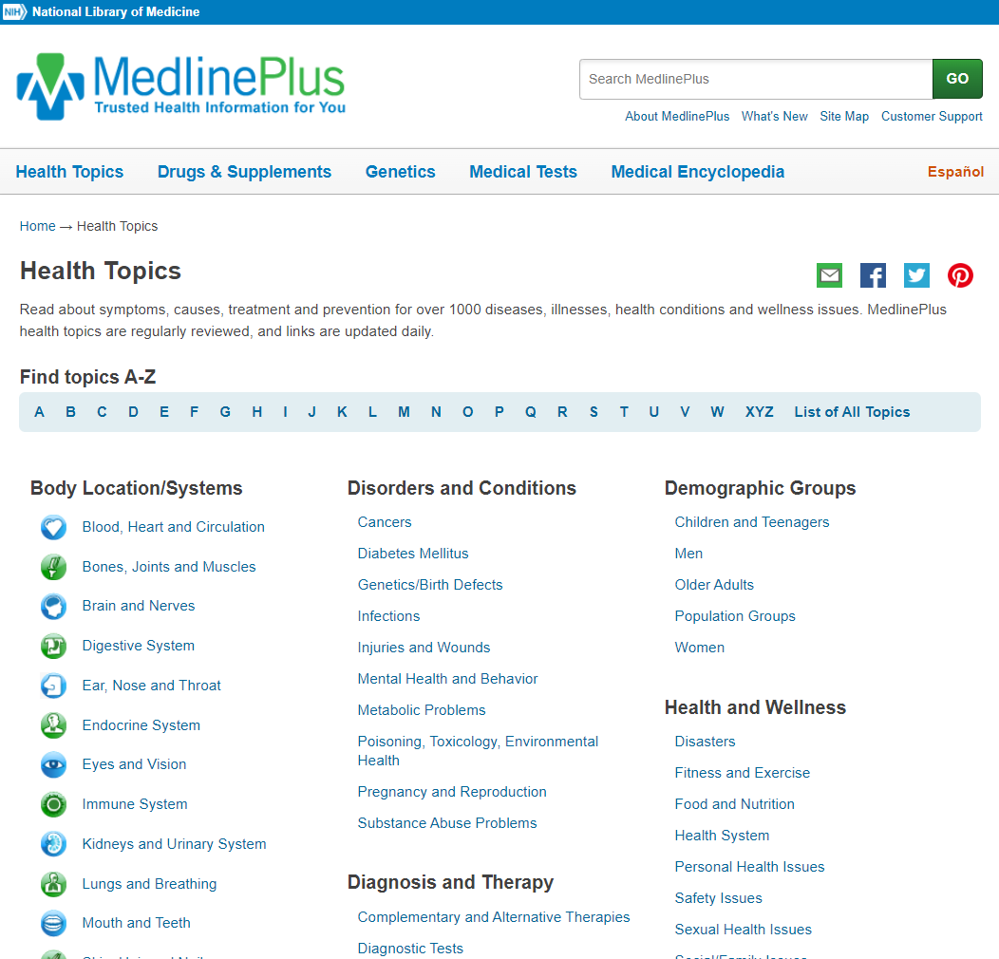
Browse by topics A-Z
or
Browse by topic areas
Notes:
Two options are available to browse health topics.
[click] Browse by topics alphabetically, including viewing a list of all topics; or
[click] Browse by five different topic areas:
Body Location/Systems;
Disorders and Conditions;
Diagnosis and Therapy;
Demographic Groups; and
Health and Wellness
Think of a health topic that interests you. How would you look for it? Would you search or browse?

Slide 14
Activity
Notes:
There are two "sizes" of health topics. Some health topics are designed to be a comprehensive resource for consumer health information needs, while certain specialized topics may contain more abbreviated information.
Compare two health topic pages.
Exercise and Physical Fitness https://medlineplus.gov/exerciseandphysicalfitness.html
How Much Exercise Do I Need? https://medlineplus.gov/howmuchexercisedoineed.html
What are some of the differences between how the information is presented in the two pages?

Slide 15
Comprehensive Health Topic
Health Topiclette
Notes:
Comprehensive health topics are designed to be a one-stop shop for patient/consumer health information on a specific health topic. Comprehensive health topics have much more information, while a Health “Topiclette” (mini-topic) is a written summary with fewer, but more specific links.
Regardless of type, note that all written content is Copyright free; Presented at a sixth-grade reading level or below.

Slide 16
Health Topic Page
Notes:
[Demonstrate a comprehensive health topic example: Breast Cancer]
https://medlineplus.gov/breastcancer.html
This is the page for the health topic: Breast Cancer. As seen on the page, health topics include six focus areas:
Basics
Learn More
See, Play and Learn
Research
Resources
For You
Each focus area is further broken down into sub-categories. Content in the sub-category varies by health topic. Clicking on these links will jump you to that section of the health topic page.
The sub-category information will change depending on the topic, but let’s look closer at what is offered on the Breast Cancer health topic page.
Basics include a written “Summary” that provides a narrative overview of the topic. “Start Here” includes the best links to external content, selected using the quality guidelines and regularly verified for currency, relevancy, and authority by MedlinePlus librarians. The sub areas “Diagnosis and Tests,” “Prevention and Risk Factors” and “Treatments and Therapies” include links to authoritative sources.
Learn More provides information about “Living With” a disease or condition, “Related Issues,” “Specific” and “Genetics” aspects related to a disease or condition.
See, Play, and Learn lists videos and tutorials, health check tools such as interactive calculators and games, and links to images.
Research provides numerical data and the latest research from the National Institutes of Health databases such as ClinicalTrials.gov and PubMed.gov.
Resources includes a “Reference Desk” of dictionaries or specific encyclopedia or glossaries. “Find an Expert” provides links to organizations and/or specialty healthcare professionals.
And finally, For You provides content for specific populations and patient handouts.

Slide 17
Link Descriptions
Notes:
[click] Each record in a MedlinePlus health topic lists the source of the information on the link, so you will know where you are going before you click on it.
MedlinePlus also has certain specially-tagged records next to the link names, including:
Specific NIH content; [click]
Easy-to-read; [click]
Also in Spanish, and [click]
Video. [click]

Slide 18
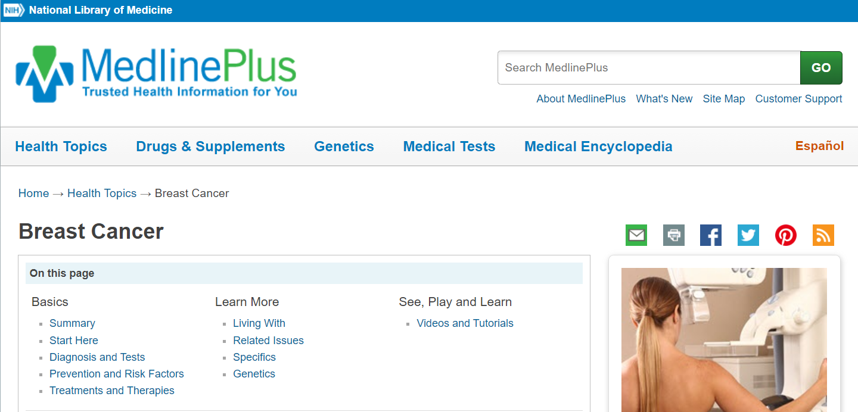
Additional Features
Notes:
While we have covered the majority of content you will see on a health topic page, there are a couple of additional features to mention.
You can view the health topic page in Spanish, by clicking the Espanol link.

Slide 19
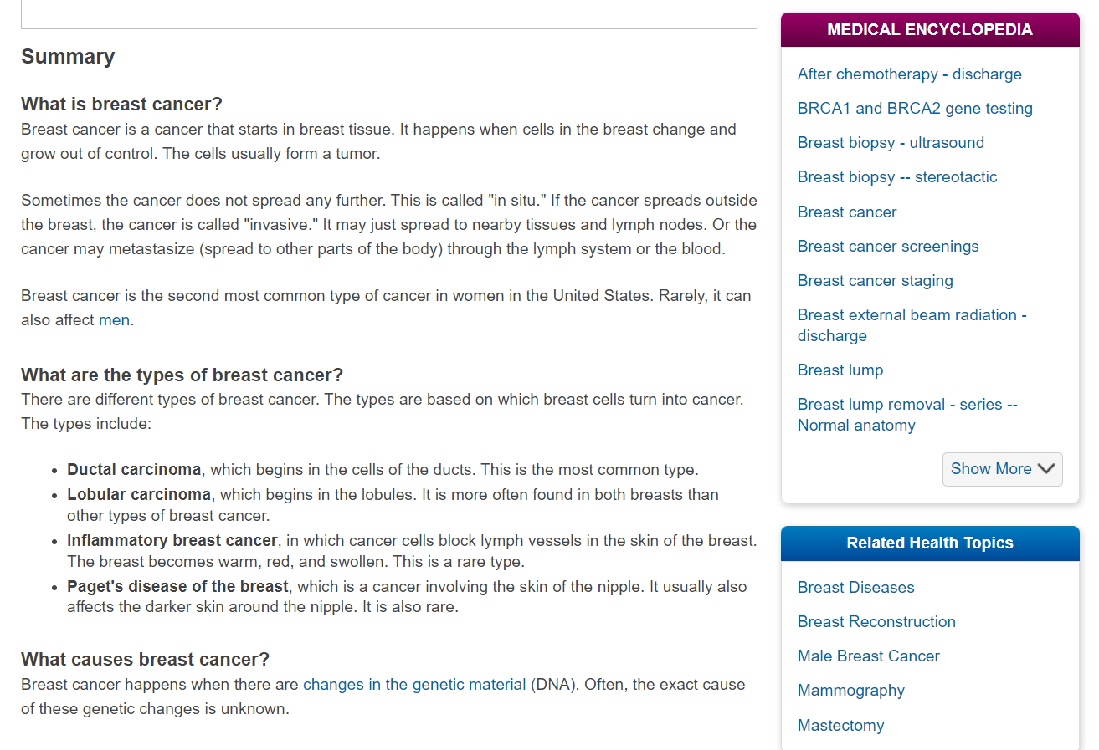
Medical Encyclopedia and Related Health Topics
Notes:
In the Medical Encyclopedia box, you will see related terms that link to the Medical Encyclopedia section of MedlinePlus. We will explore the Medical Encyclopedia later on in this presentation.
In the Related Health Topics box, you will see links to additional health topics that are relevant to the page you are viewing.

Slide 20
Drugs & Supplements
Notes:
Next, we will review the “Drugs & Supplements” section of MedlinePlus.
According to studies of consumer information-seeking behaviors, consumers need information about a prescription or over-the-counter drug’s safety, efficacy, and potential interactions or side effects. Specifically, they have questions about antibiotics and vaccines.
Consumers are also looking for information about herbs and supplements. The National Health and Nutrition Examination Survey found in 2012 that 52% of Americans took at least one dietary supplement, with a multivitamin being the most common. Consumers want to know about the efficacy, side effects, and administration of the supplements they’re taking.
The Drugs and Supplements section of MedlinePlus provides this information for more than 1000 records on prescription and over-the-counter medication, herbs, and supplements, all from licensed content.
Like health topics, you can find drug and supplement information by using the search box or browsing alphabetically.

Slide 21
Search Drugs and Supplements
Notes:
Let’s practice using the search box again to search for the ADHD drug Ritalin.
First, locate the search box on the webpage.
Type “Ritalin” in the search box and click “Go”

Slide 22
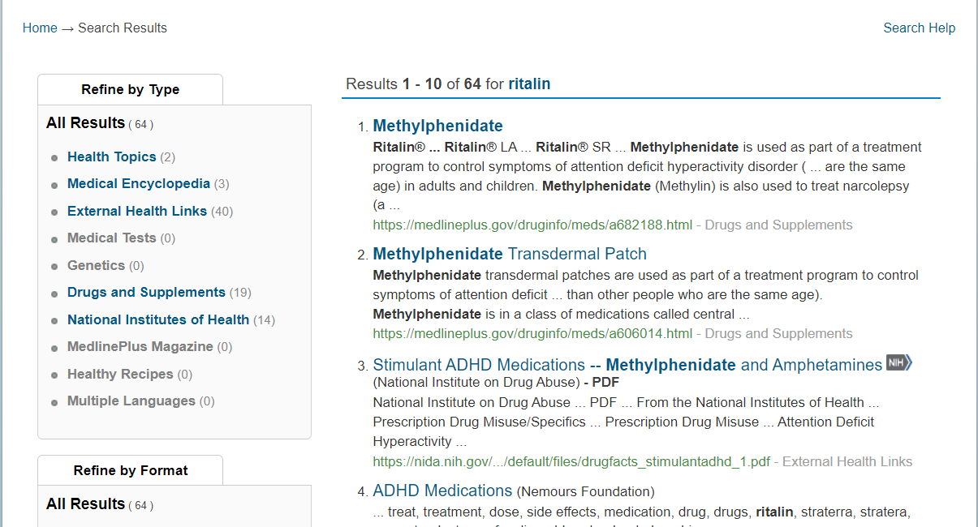
Labels on Results Page
Notes:
Looking at the initial search results, we see a mix of records from “Drugs & Supplements,” “External Health Links,” and other sources. [click] To answer basic consumer questions, use the “Drugs & Supplements” records. [click] The “External Health Links” and other sources provide additional information about specific conditions a medication treats or how it is different from other drugs.
Using the “Refine by Type”, [click] let’s filter our results to only Drugs & Supplements records.
Click on “Drugs and Supplements” under the “Refine by Type” box.

Slide 23
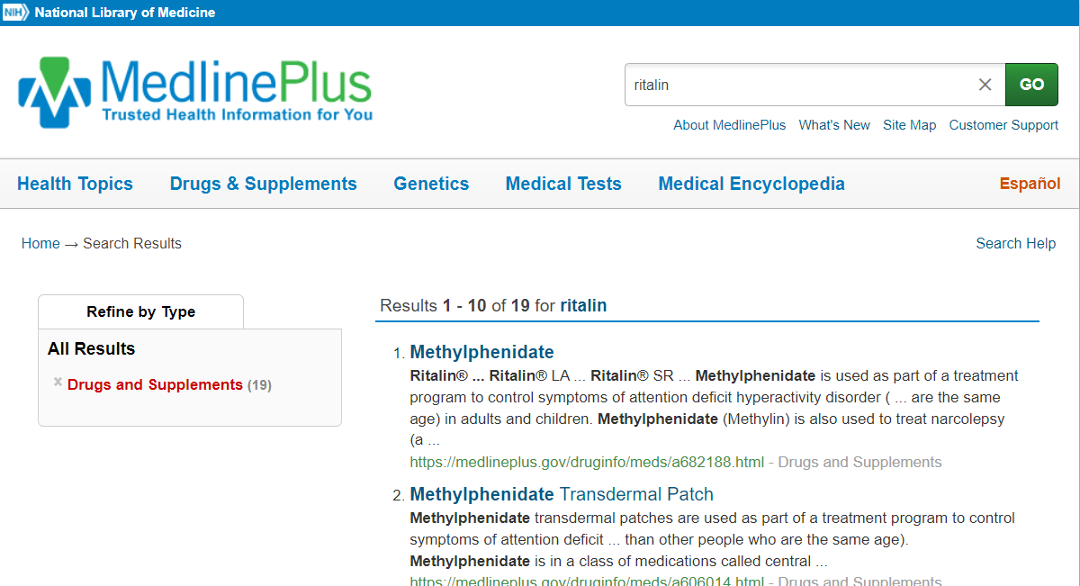
Results Page for Ritalin
Notes:
The search results have been reduced to showing only those under Drugs & Supplements. The information on drug pages is licensed from the American Society of Health-System Pharmicists ; it is updated monthly by a panel of reviewers and editors.
Notice that the top result is for Methylphenidate. The drug database uses both brand and generic names for drugs. Methylphenidate is another term for Ritalin, which you can confirm in the “Brand Names” section of the drug page
Click on “Methylphenidate”

Slide 24
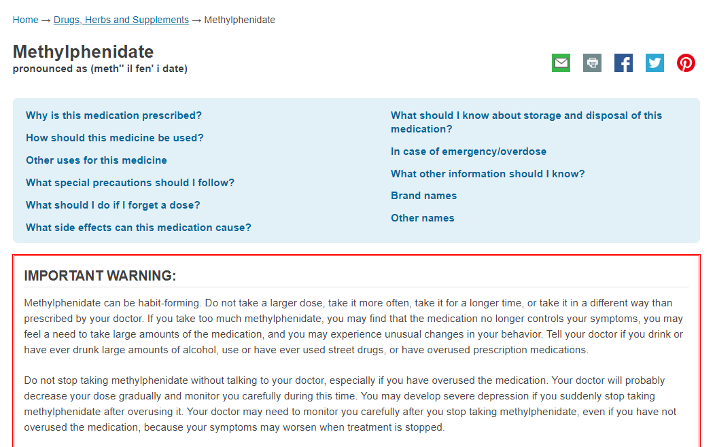
Drug Record Page
Notes:
The drug record consists of a series of questions that links to answers within the page. [click] The content includes why that particular medication would be prescribed, how it should be used, possible side effects, storage requirements and more.
[click] Also note the important warning box on the page, which includes any safety precautions for the drug. These only appear for drugs that have been issued a warning by the FDA.

Slide 25
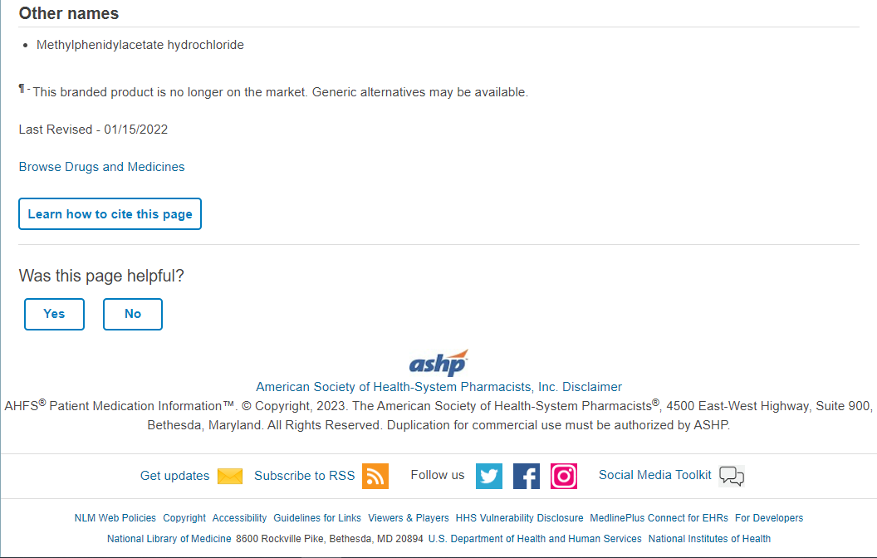
Citation
Notes:
When you scroll down to the bottom of the Methylphenidate page, you will see that the drug record is licensed information from the American Society of Health-System Pharmacists (or ASHP).
The ASHP logo appears on drug pages from this source.
[click] A “last revised” date is also important to note at the bottom of the page.

Slide 26
Browsing Drugs and Supplements
Notes:
As mentioned, another way to search for drugs and supplements is by browsing. This involves going to the Drugs & Supplements section of the website.
Click on Drugs & Supplements in the navigation menu.

Slide 27
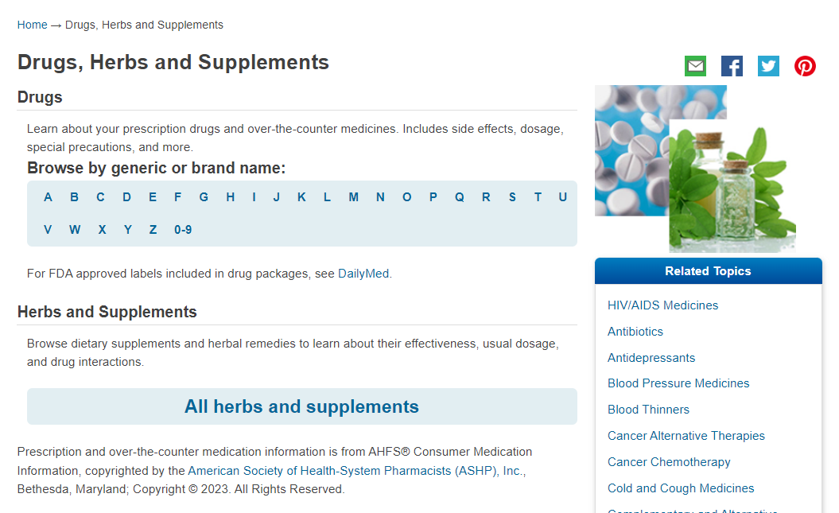
Browsing Drugs, Herbs, and Supplements
Notes:
Drug and supplement information comes from several reliable sources. As noted in the previous example, licensed drug information comes from the American Society of Health-System Pharmacists. Most herb and supplement information comes from the NIH Office of Dietary Supplements and the Natural Medicines Comprehensive Database consumer version, which is licensed information.
[click] The Drugs & Supplements section allows you to browse either generic or brand name drugs alphabetically. [click] You can also separately browse herbs and supplements.
Click “All herbs and supplements” to browse.

Slide 28
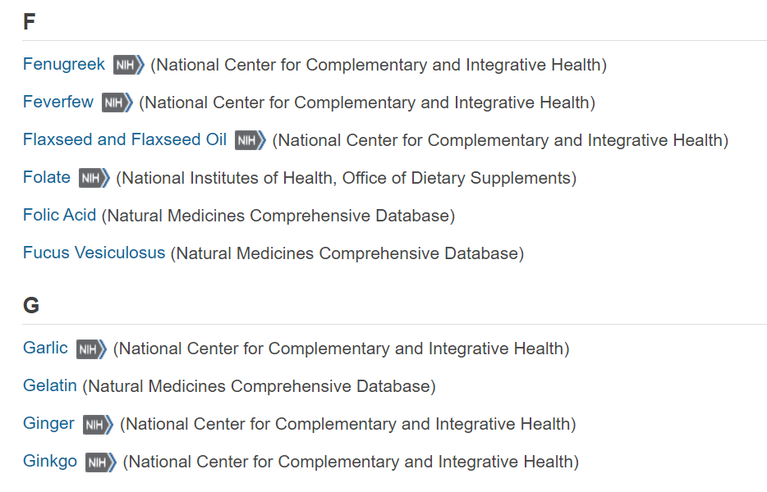
Herbs and Supplements Example 1
Notes:
Scroll down to “F.” Notice all herbs and supplements are listed alphabetically and some include an NIH icon. An icon indicates that the link leads to an external website, like the National Institutes of Health Office of Dietary Supplements.
Click on the record for “Folate,” which is from the NIH Office of Dietary Supplements.

Slide 29
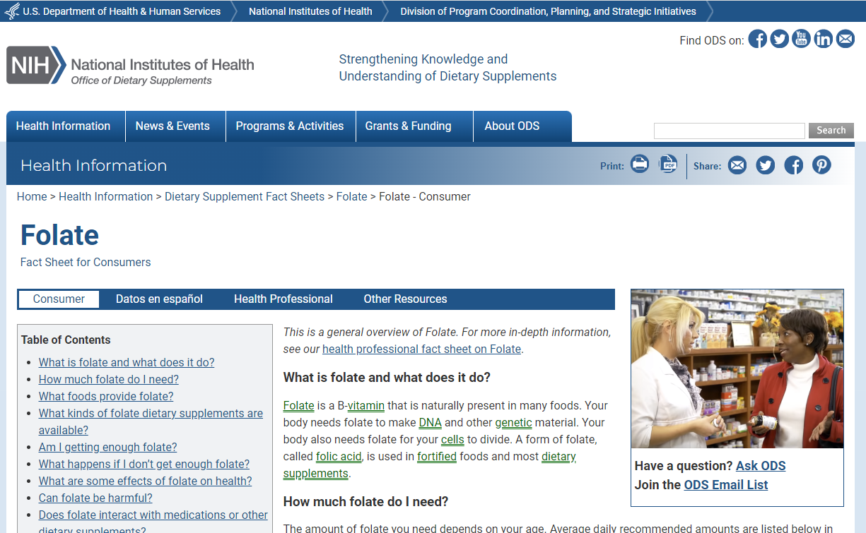
Herbs and Supplements Example 1 Continued
Notes:
You will notice that it opens in a new window, linking to the Office of Dietary Supplements website.
It includes sections that answer common consumer questions, like “Am I getting enough folate?”

Slide 30
Herbs and Supplements Example 2
Notes:
Back on the “Herbs and Supplements” alphabetical listing, click on the record for “Gelatin.”

Slide 31
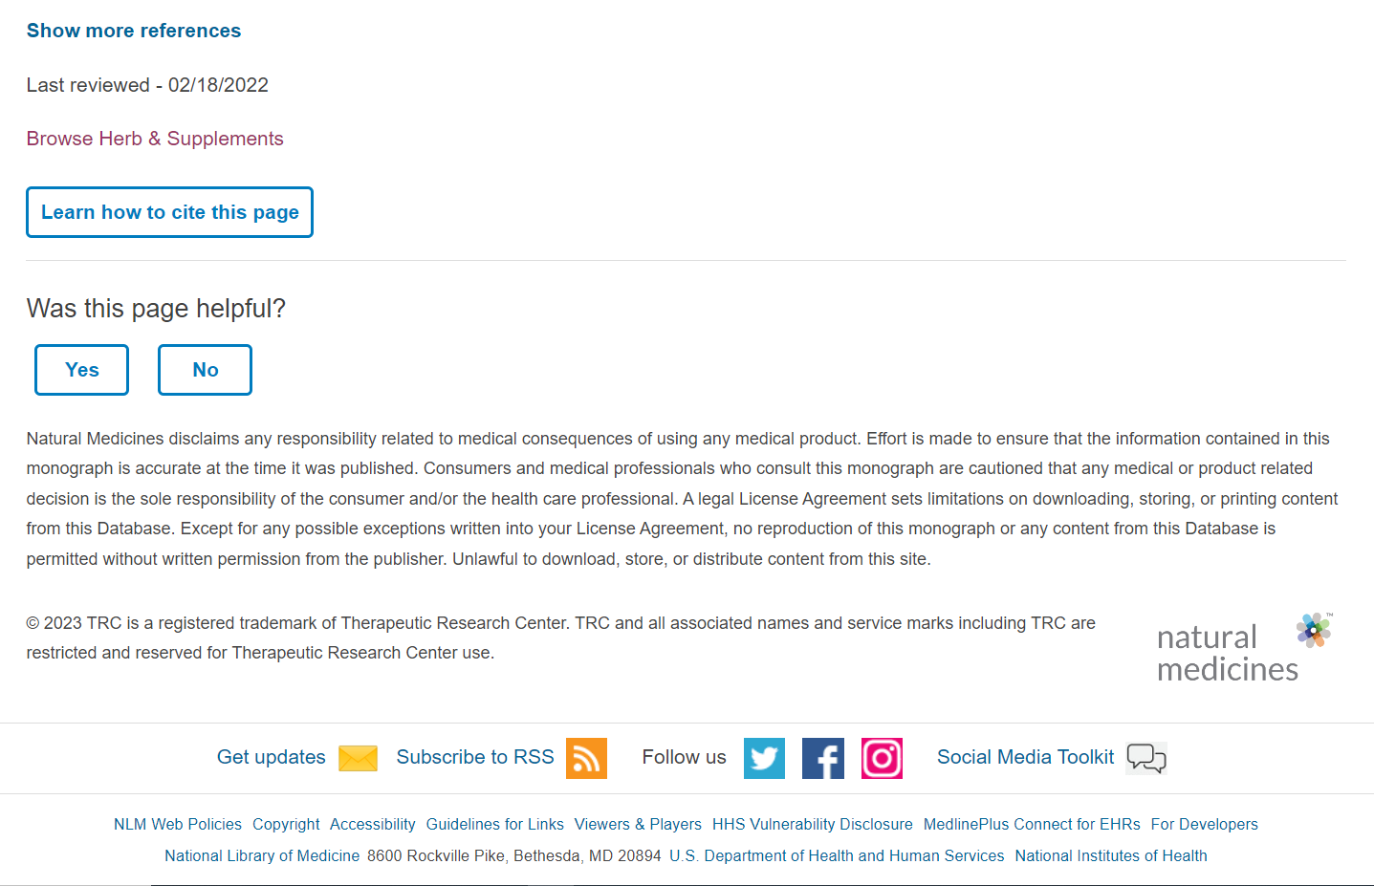
Herbs and Supplements Example 2 Continued
Notes:
You will notice that it opens a page within MedlinePlus, similar to a drug page.
[click] Scrolling to the bottom of the page, you will see the logo for the Natural Medicines Comprehensive Database as well as a “last revised” date. [click]

Slide 32
Genetics
Notes:
MedlinePlus Genetics contains information originally created for NLM’s Genetics Home Reference resource. In October 2020, content from Genetics Home Reference was integrated into MedlinePlus.
The genetics section of MedlinePlus includes information on more than 2,800 pages about genetics, genetic conditions, and the genes or chromosomes related to those conditions.
Click on “Genetics” in the navigation menu.

Slide 33
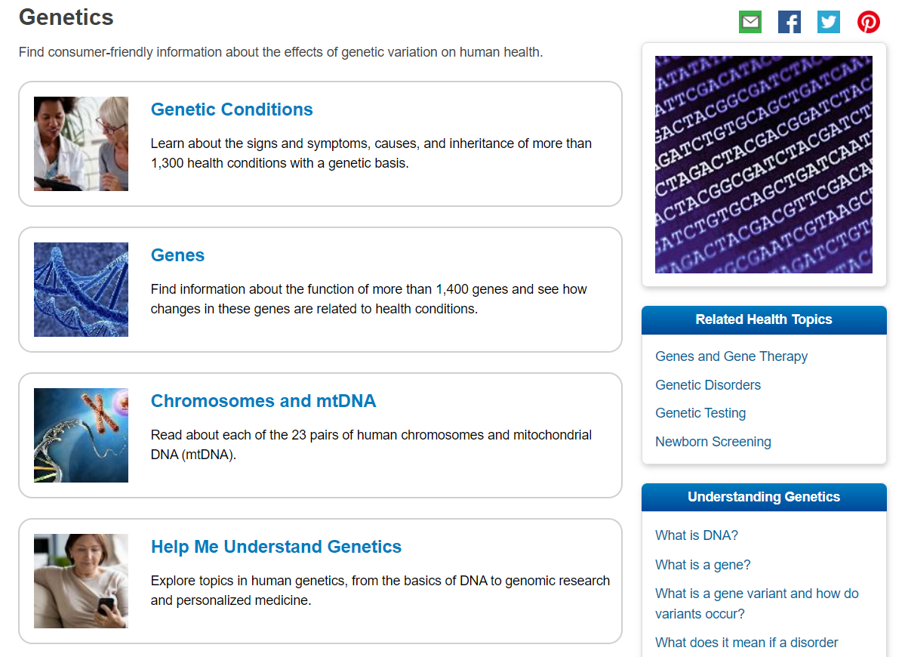
Genetics Sections
Notes:
MedlinePlus Genetics contains four major sections.
The Genetic Conditions section allows you to browse alphabetically for signs, symptoms, cause, and more.
In the Genes section you can also browse gene information alphabetically.
Under Chromosomes and Mitochondrial DNA (mtDNA), you can browse for information by one of the 23 pairs of chromosomes or by Mitochondrial DNA.
The Help Me Understand Genetics area offers a basic explanation of how genes work and how mutations cause disorders, as well as current information about genetic testing, gene therapy, genetics research, and precision medicine.
Let’s look for more information about a genetic condition: Down syndrome.
[click] Click on “Genetic Conditions.”

Slide 34
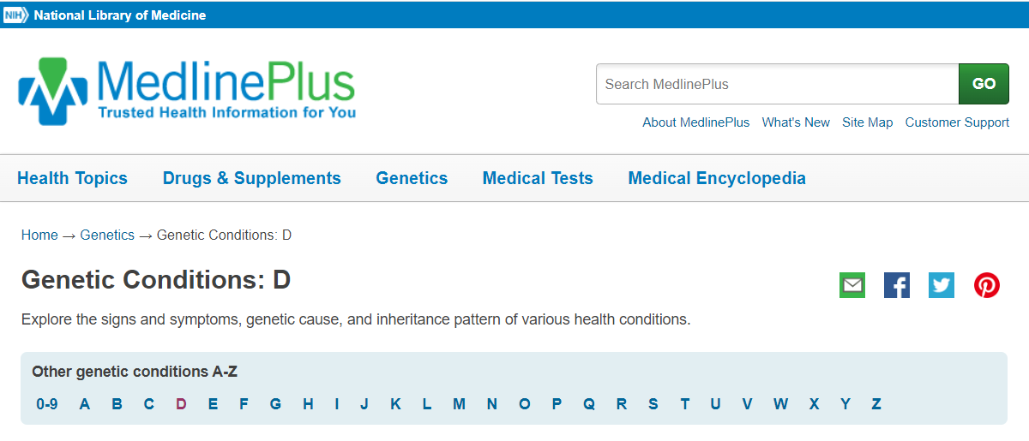
Genetic Conditions Example
Notes:
In the alphabetical list, [click] click on the letter “D.”
Then, [click] click on “Down syndrome.”

Slide 35
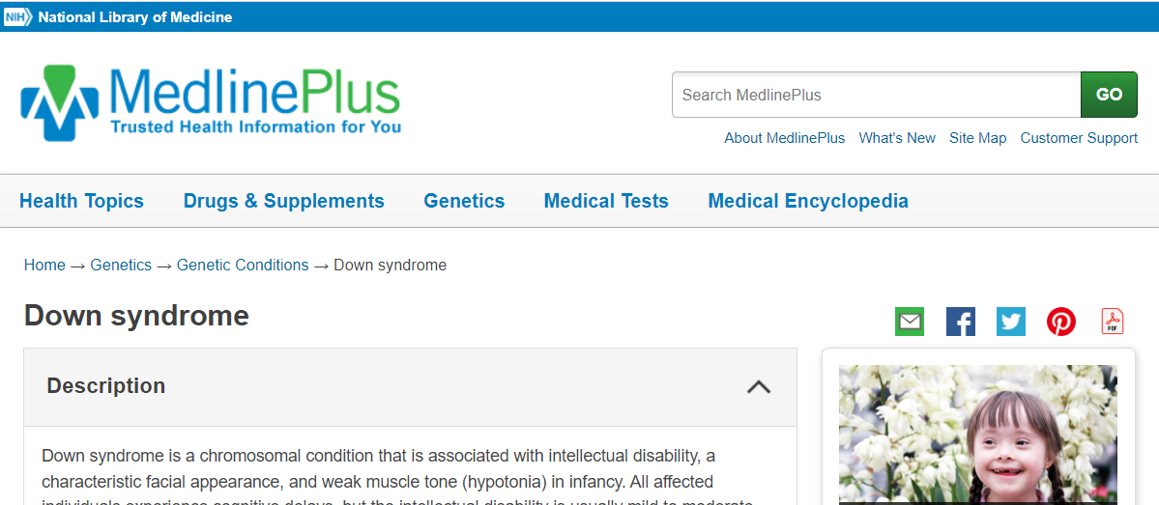
Genetic Conditions Example Continued
Notes:
On a genetic conditions page, you will see a detailed description of the condition. Further down the page is more detail about the frequency, causes, inheritance likelihood and other names of the genetic condition.
There are links to additional information and references.

Slide 36
Help Me Understand Genetics
Notes:
Now, let’s look a little closer at the Help Me Understand Genetics area of MedlinePlus.
Help Me Understand Genetics is an introduction to fundamental topics related to human genetics, including illustrations and basic explanations of genetics concepts.

Slide 37
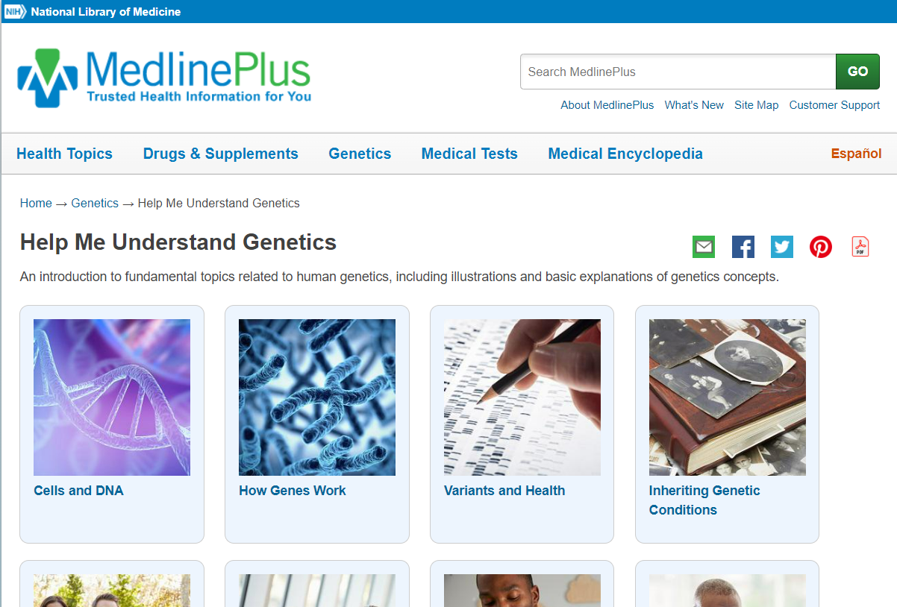
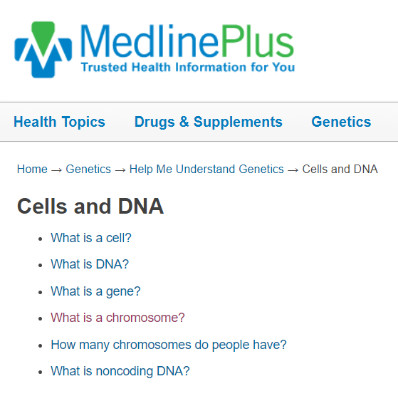
Cells and DNA
Notes:
Let’s search for information about chromosomes.
On the Help Me Understand Genetics page, [click] click on “Cells and DNA.”
On the next page, [click] you will see a list of common questions related to the topic of cells and DNA.
Click on “What is a chromosome?” [click]

Slide 38
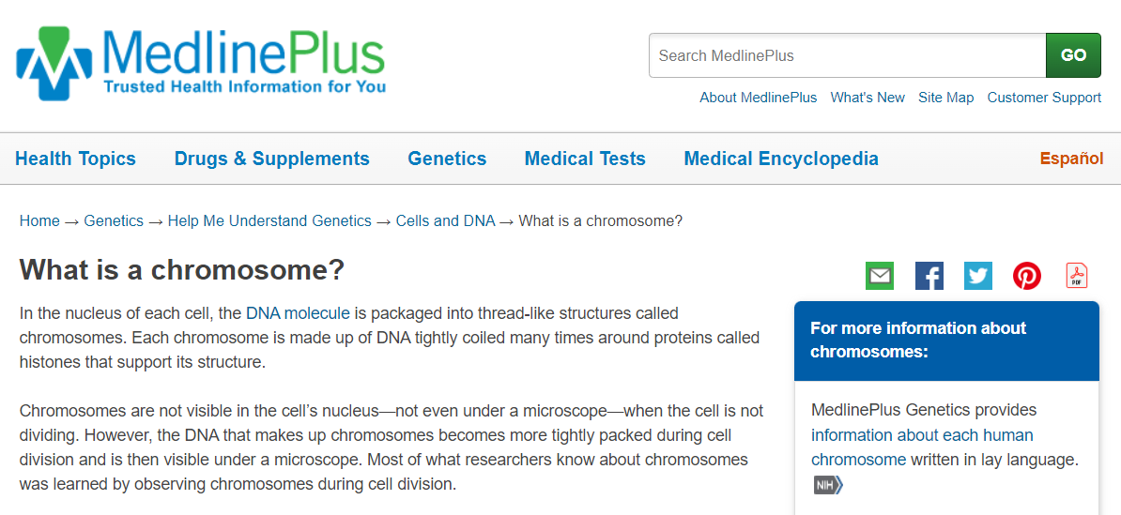
What is a chromosome?
Notes:
Here is a descriptive answer to the question: “what is a chromosome?” The page also includes links to additional information from trusted resources in the box “For more information about chromosomes:”
As you can see, MedlinePlus Genetics is a comprehensive resource for users to learn and find appropriate, authoritative information about human genetics.

Slide 39
Medical Tests
Notes:
MedlinePlus offers more than 300 articles about medical tests. These pages explain what the tests are used for, why a doctor may order them, how a test will feel, and what the results may mean. This content is created, translated, and maintained by NLM staff and contractors.
Click on Medical Tests in the navigation menu.

Slide 40
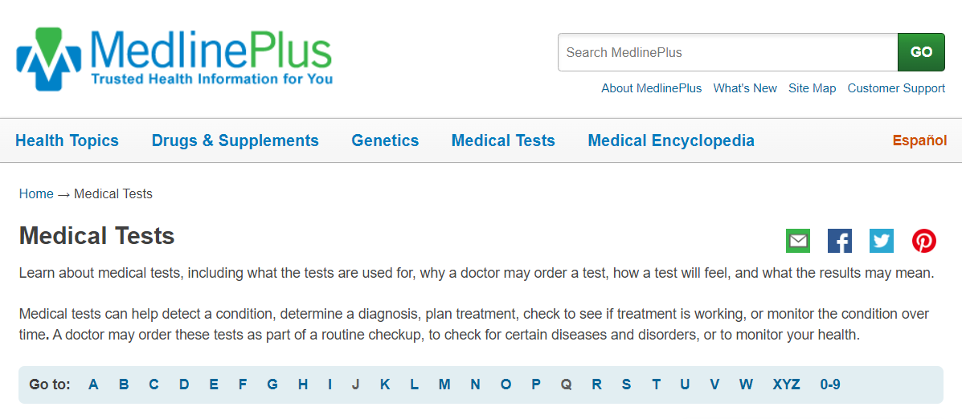
Medical Tests Example
Notes:
MedlinePlus offers an A–Z list of common medical tests. You can also use the search box to locate medical tests.
Click on “Glucagon Blood Test”

Slide 41
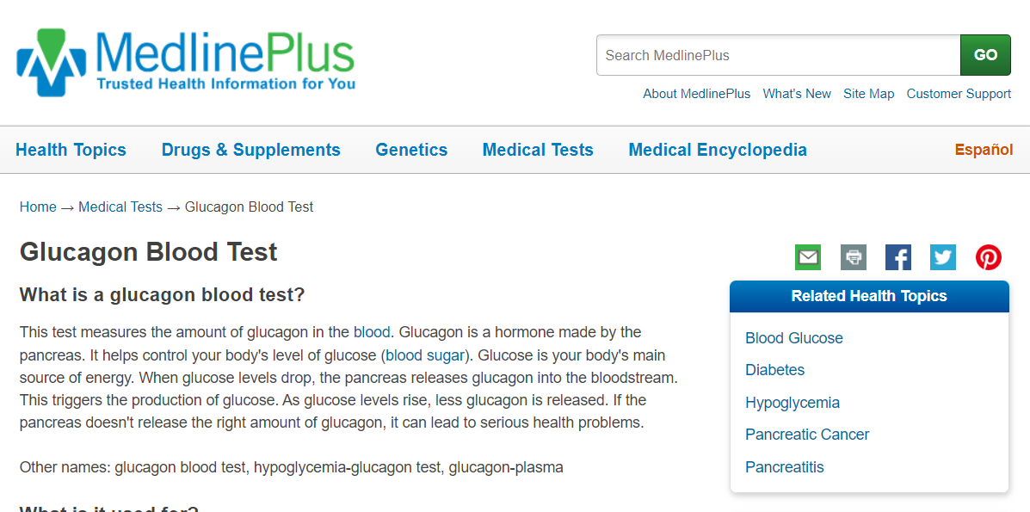
Medical Tests Example Continued
Notes:
This is a Medical Test record page. Notice that it provides:
A summary of what the medical test is;
What it’s used for;
Why someone would need it;
What to expect during the test;
How to prepare for the test; and
Possible risks and results.
The record also includes links to related MedlinePlus health topics and other medical tests.

Slide 42
MedlinePlus in Spanish
Notes:
Additional features on the MedlinePlus website include: MedlinePlus in Spanish; Medical Encyclopedia; and Links to more resources.
Much of MedlinePlus is available in Spanish including the Medical Encyclopedia, Drugs database, Herbs and Supplements, and Medical Tests. You can toggle between the English and Spanish pages.
Let’s try it.
Click on the orange “Español” link at the top of the page content.

Slide 43
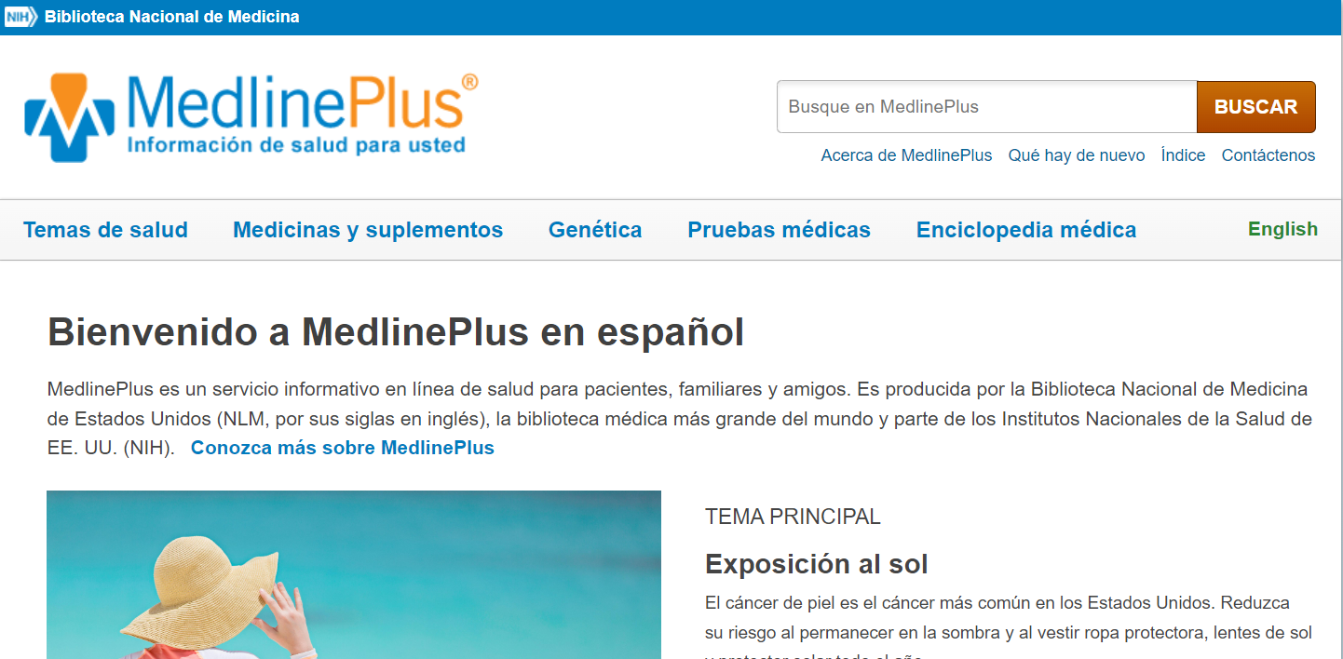
MedlinePlus in Spanish Continued
Notes:
What difference do you see?
The Spanish site is a mirror of the English site as far as layout and much of the content. When exploring the English version of MedlinePlus, for those pages that are available in Spanish, you will see the Español link at the top of the page.
When viewing a page in Spanish, notice that the orange Español link has changed to a green English link.
Click on green “English” link to return to the English version of the home page.

Slide 44
Medical Encyclopedia
Notes:
MedlinePlus also includes a medical encyclopedia of more than 4,000 articles, videos and graphics available in English and Spanish. MedlinePlus licenses the Medical Encyclopedia from A.D.A.M.
Click on “Medical Encyclopedia” on the navigation menu.

Slide 45
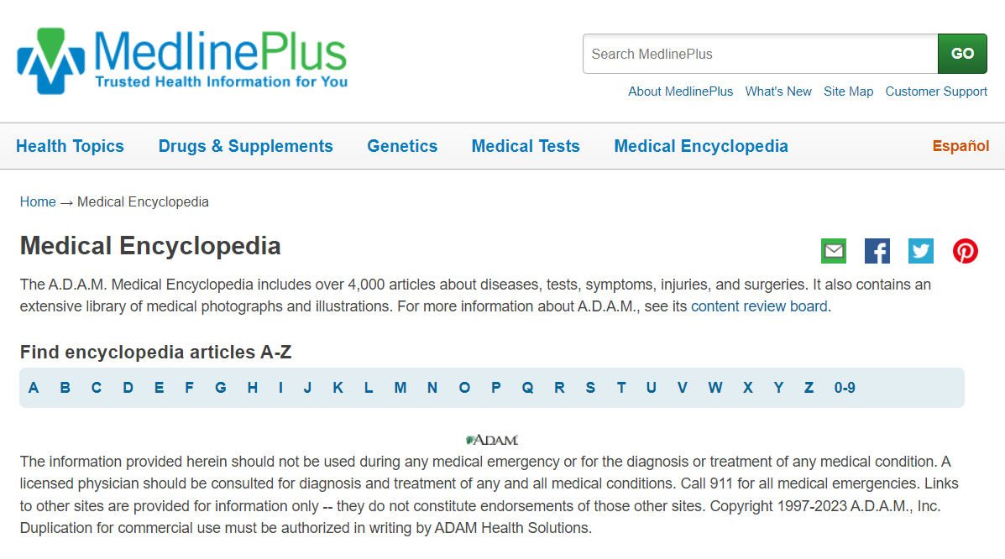
Medical Encyclopedia Continued
Notes:
[click] You can search the Medical Encyclopedia using the A–Z List. Notice again that the source is A.D.A.M. [click]

Slide 46
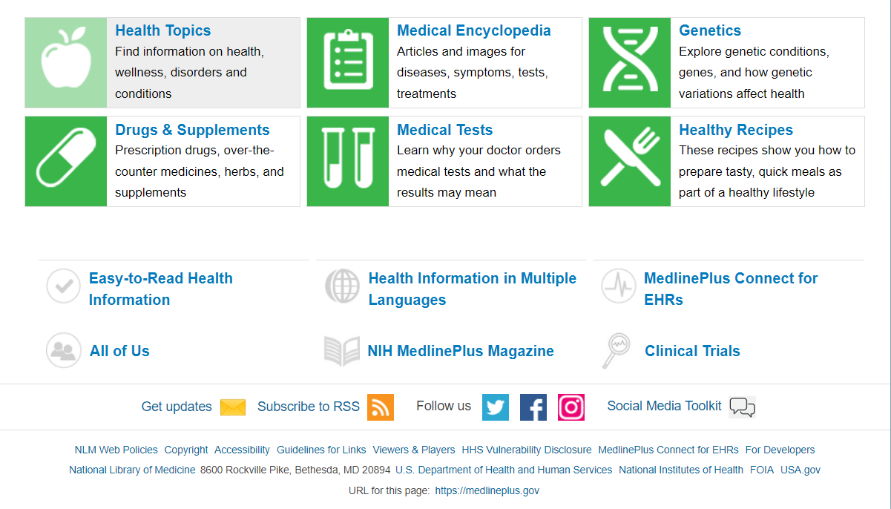
Additional Resources
Notes:
In addition to what was covered today, various resources are accessible on MedlinePlus.
MedlinePlus also includes: [click]
Healthy recipes – which you can browse by type of meal or diet; [click]
Easy-to-read materials – which shows an alphabetical list of consumer health materials on a variety of health topics that are easy to read, understand and use. [click]
Social media – linking to MedlinePlus’ Twitter, Facebook, and Instagram pages; [click]
Quarterly NIH MedlinePlus magazine – which provides updates on the latest breakthroughs from NIH-supported research, as well as health tips and wellness overviews vetted by NIH experts.

Slide 47
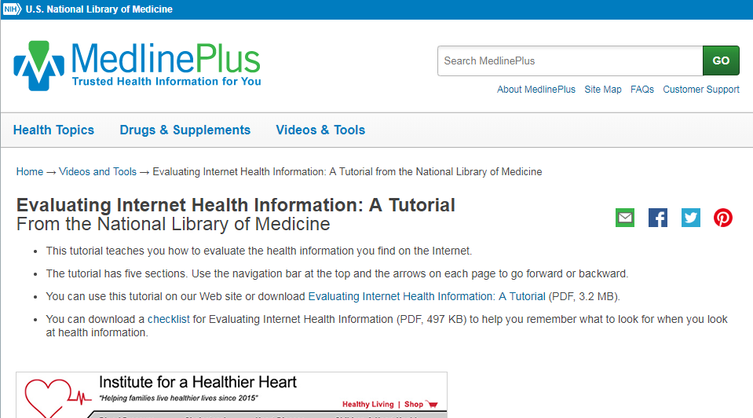
Evaluating Internet Health Information
Notes:
Thinking about health information literacy, please note that MedlinePlus contains a tutorial for everyone on Evaluating Internet Health Information.
You can download a version of the tutorial for use when no Internet connection is available

Slide 48
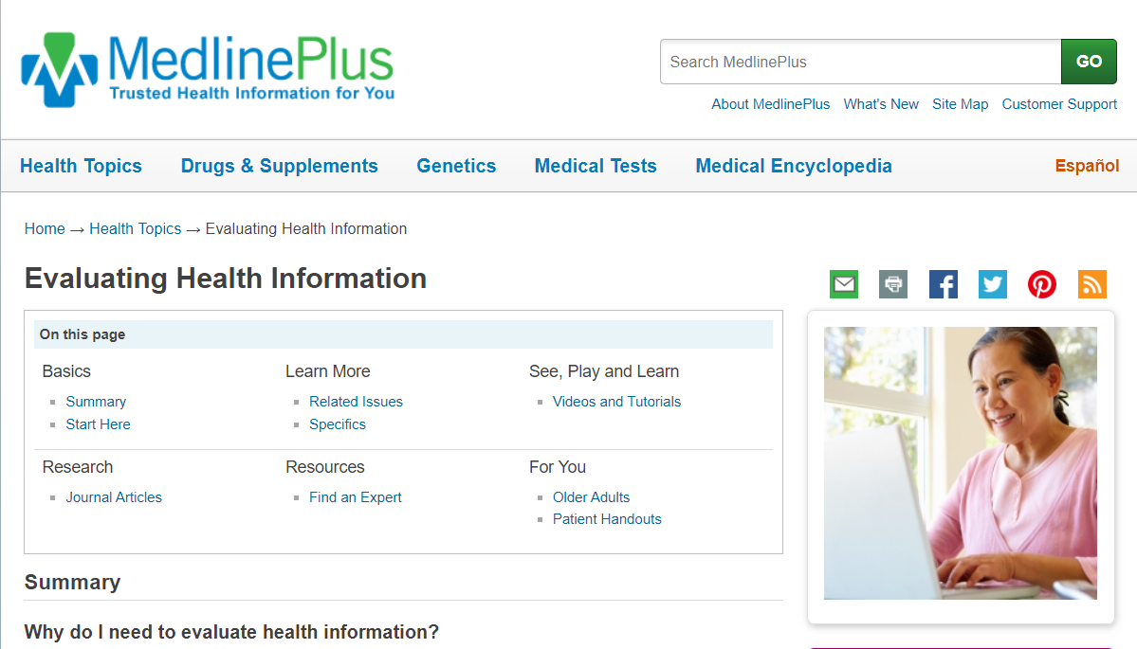
Evaluating Internet Health Information Continued
Notes:
Other organizations have also created some great content to help consumers evaluate health information on the web.
We’ve collected these into a topic page titled - Evaluating Health Information.

